Slide 1
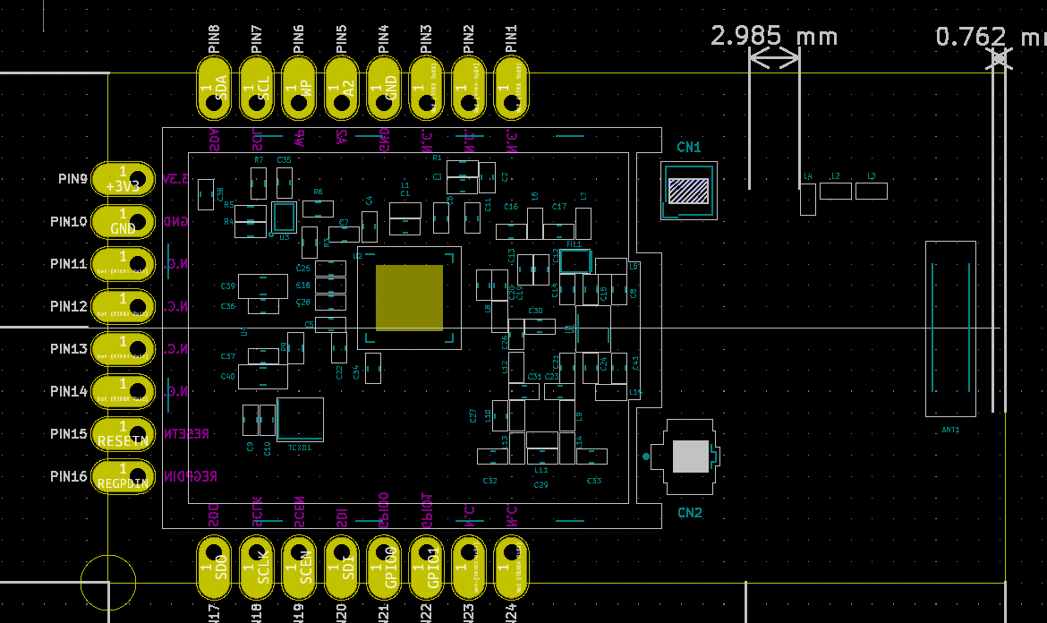
SCL
GND
SDA
WP
A2
NC
NC
NC
3V3
GND
NC
NC
NC
NC
RESETN
REGPDIN
SCLK
GPIO0
SCEN
GPIO1
SDO
SDI
NC
NC

Slide 2
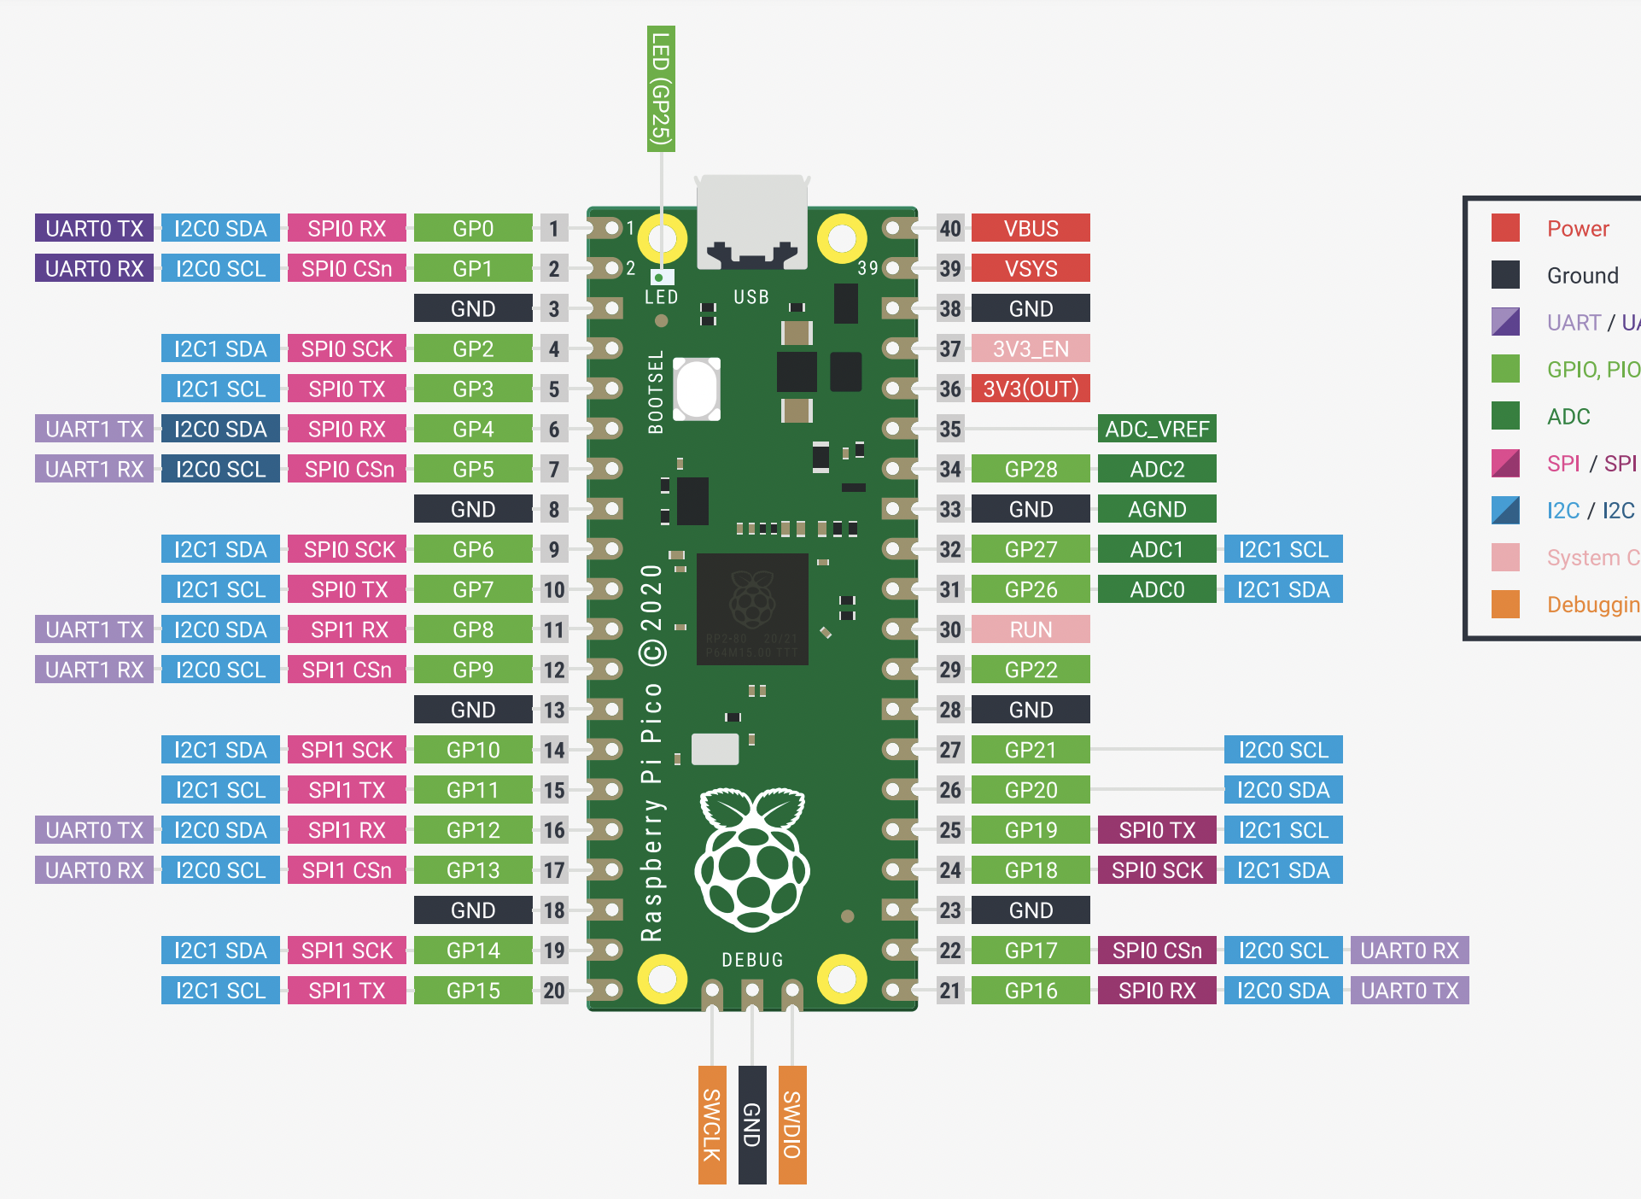
Raspberry Pi Pico

Slide 3
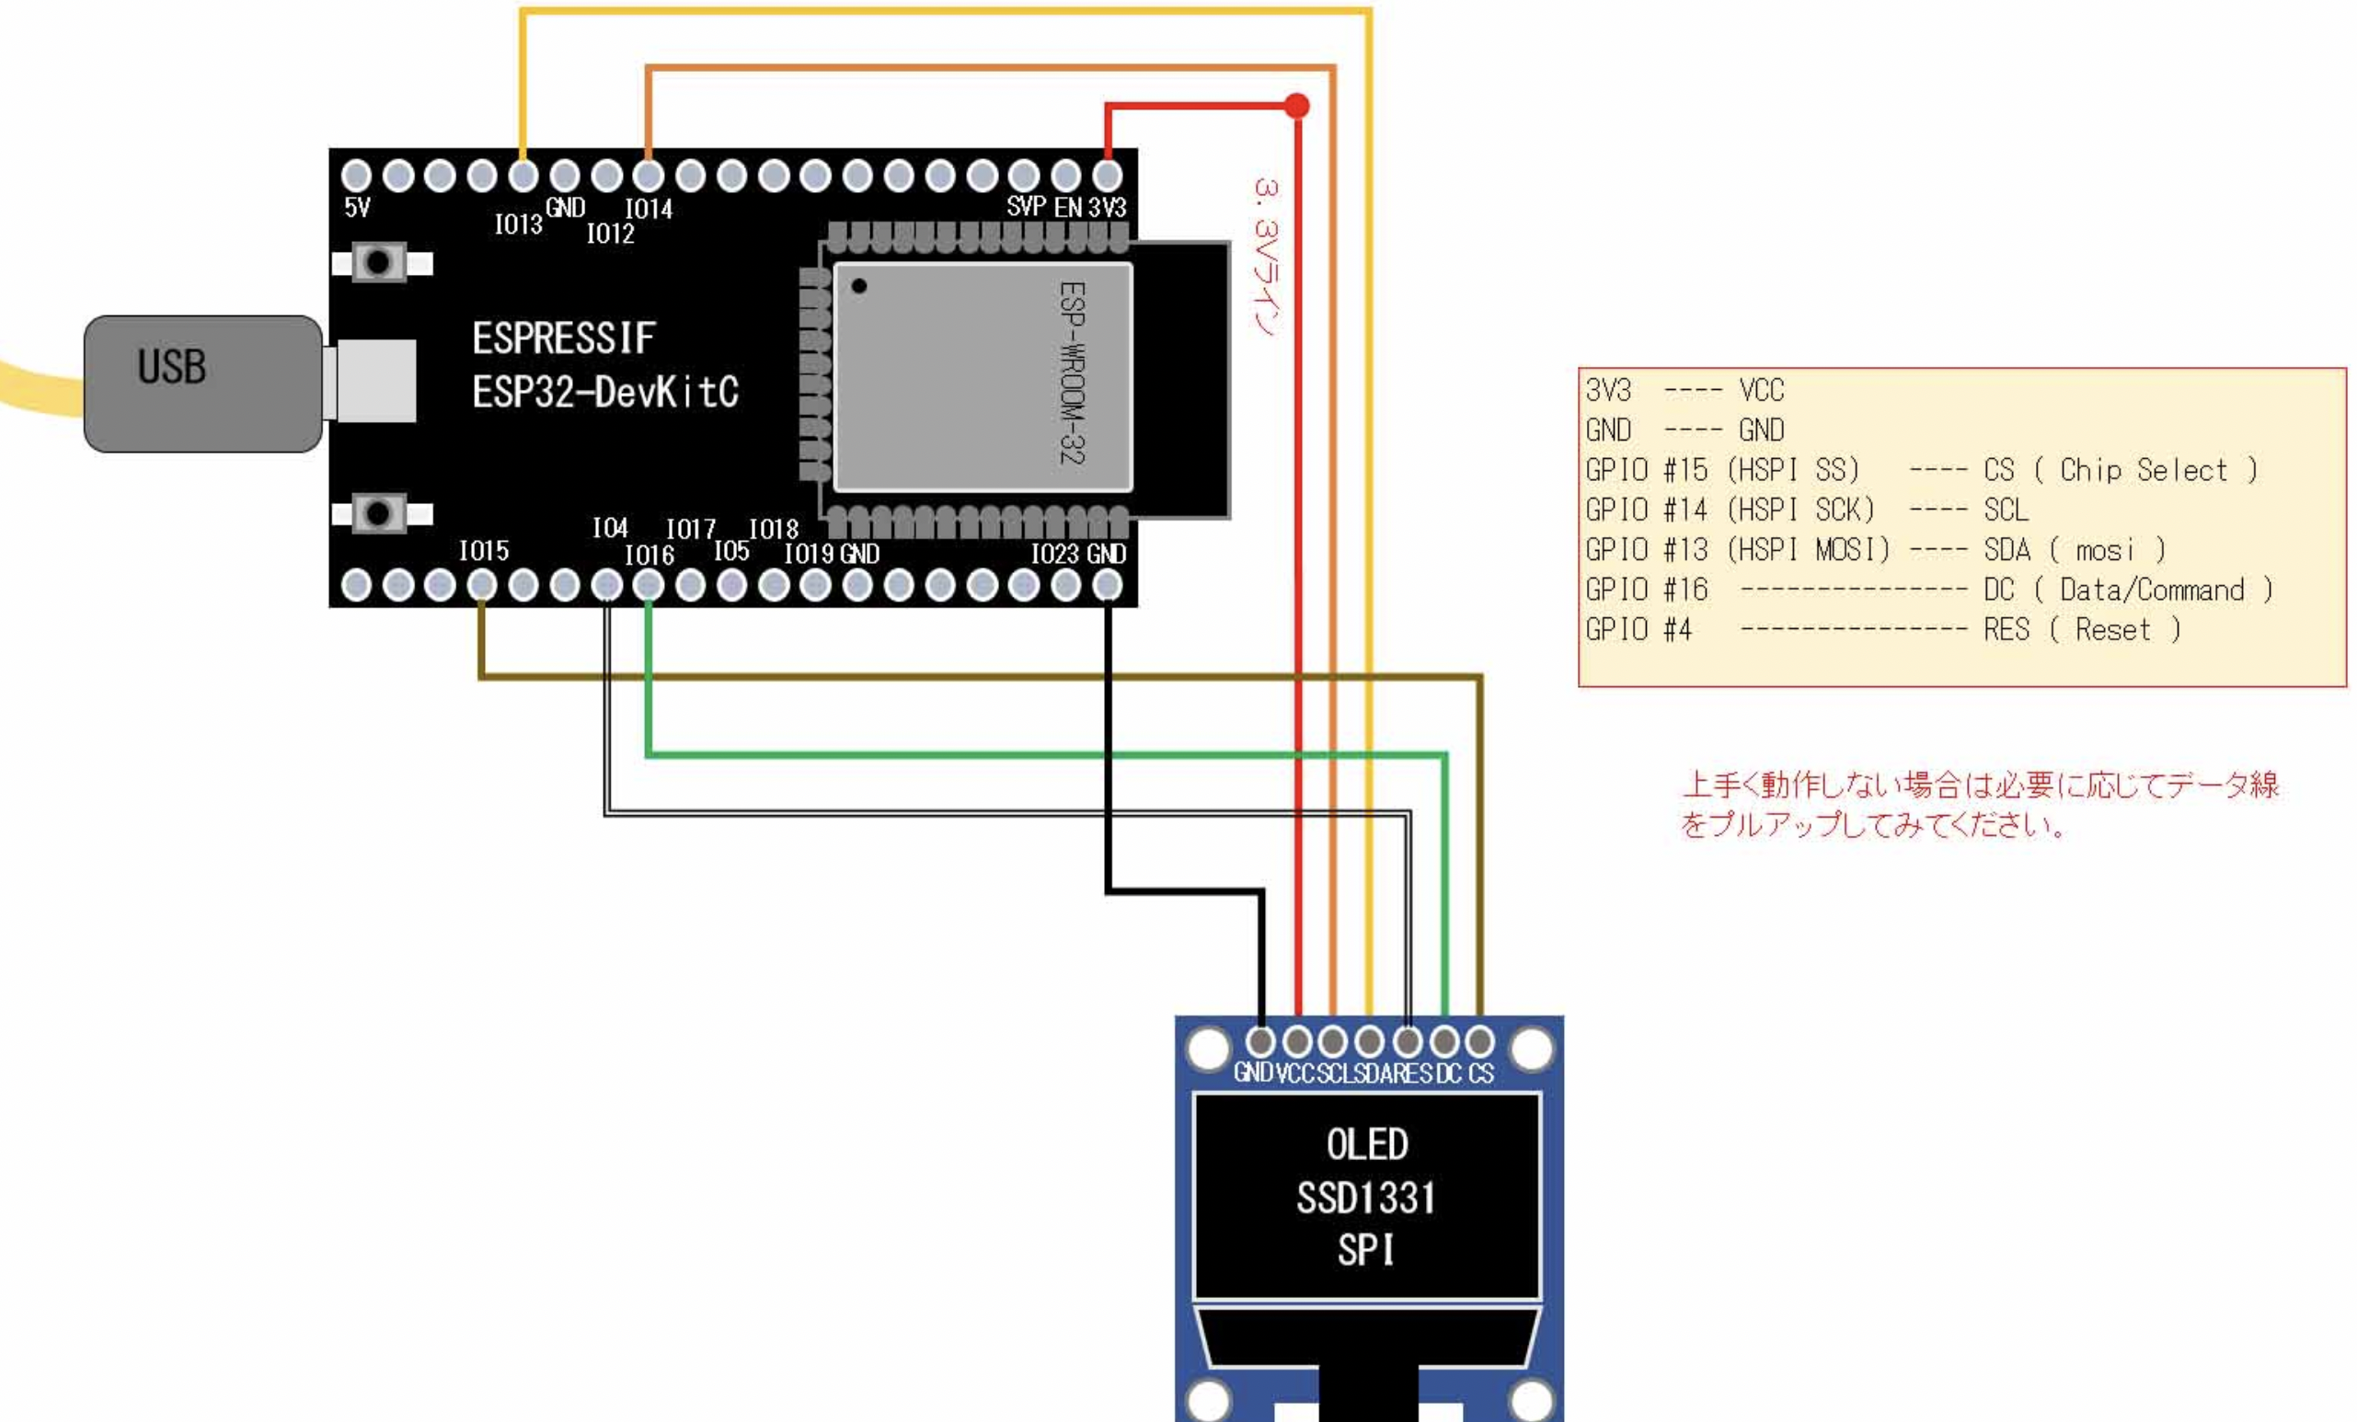
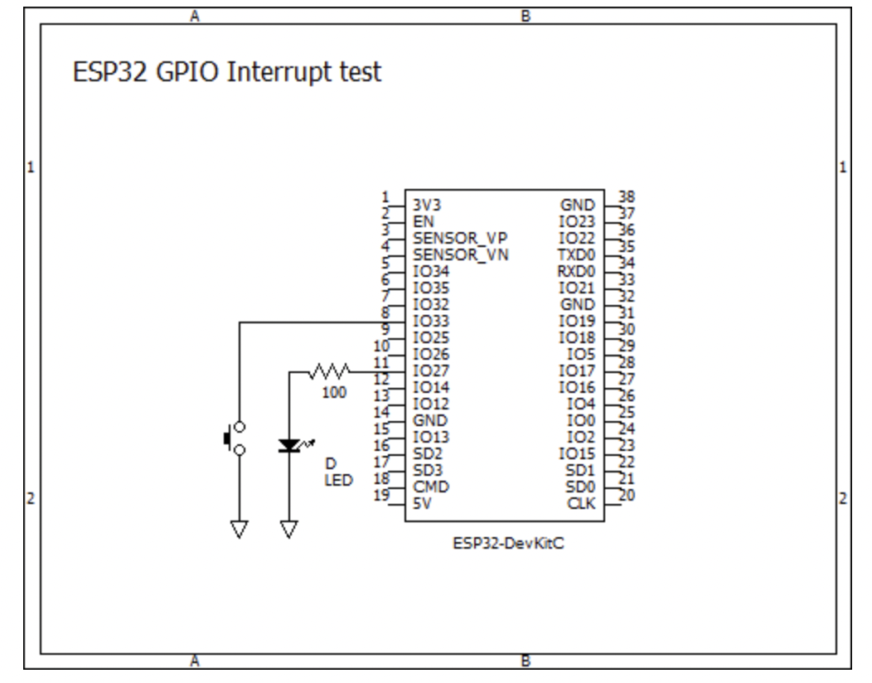
ESP32-DevKitC
ソース:
https://blog.goo.ne.jp/jh7ubc/e/8c97dc4bfad4f93d44301f8341083a69
https://leico.github.io/TechnicalNote/Arduino/esp32-i2cscan
Notes:
w

Slide 4
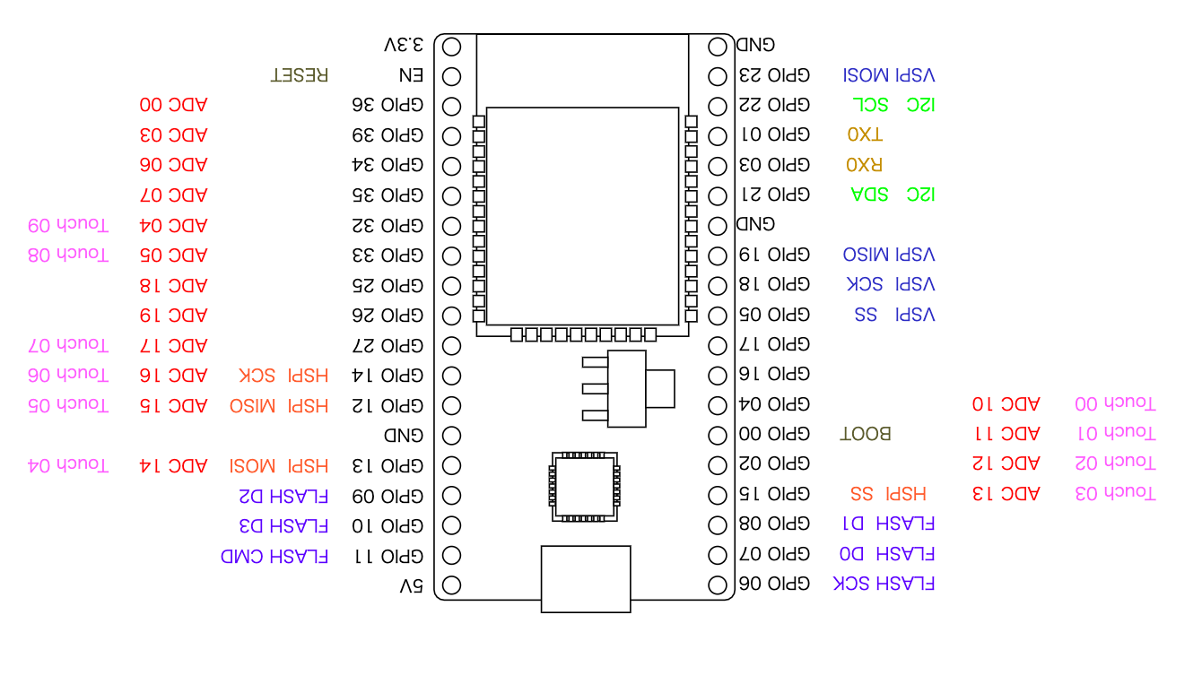
ESP32-WROOM-DevKitC

